Slide 1
ASTechNerd - Java 8 (Collections, Lambda Expressions & Streams)
Sep 27th, 2019

Slide 2


Slide 3
Welcome – Java 8 Enthusiasts
Class X <X>{X(X x){}}
interface Printer1 {
default void print() {System.out.println("Printer1");}}
interface Printer2 {
default void print() {System.out.println("Printer2");}}
class Printer implements Printer1, Printer2 {}
public class Test {
public static void main(String[] args) {
Printer printer = new Printer();
printer.print();
}}
class M {
private int num1 = 100;
class N { private int num2 = 200; }
public static void main(String[] args) {
M outer = new M();
M.N inner = outer.new N();
System.out.println(outer.num1 + inner.num2);
}}
https://mysourcesocial.bnymellon.net/people/XBBNXB4/blog/2019/09/24/oracle-codeone-2019-java-data-banking-and-more

Slide 4
Welcome – Java 8 Enthusiasts
class Player {
String name;
int age;
Player(String name, int age) {
this.name = name;
this.age = age;
}
public String toString() {
return name + ", " + age;
}
public boolean equals(Player player) {
if(player != null && this.name.equals(player.name) && this.age == player.age) {
return true;
}
return false;
}}}}
public class Test {
public static void main(String[] args) {
Object p1 = new Player("Sachin", 44);
Object p2 = new Player("Sachin", 44);
System.out.println(p1.equals(p2));

Slide 5
Collections

Slide 6
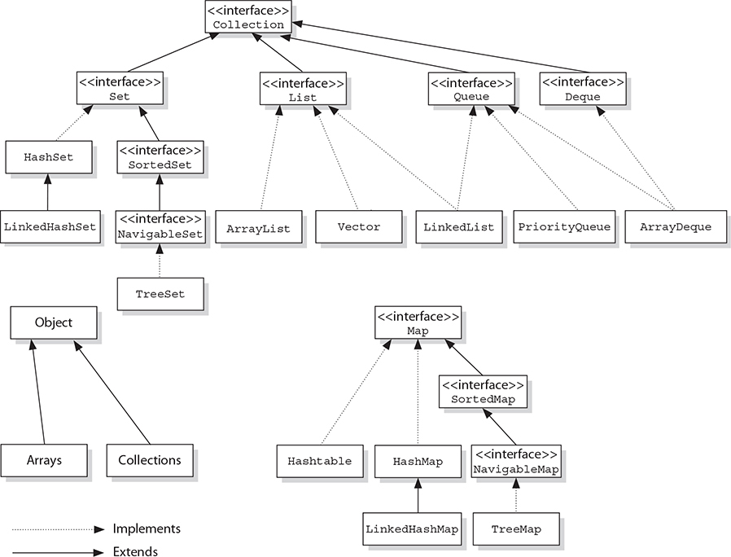
Collections
Four flavors – List, Set, Map & Queue

Slide 7
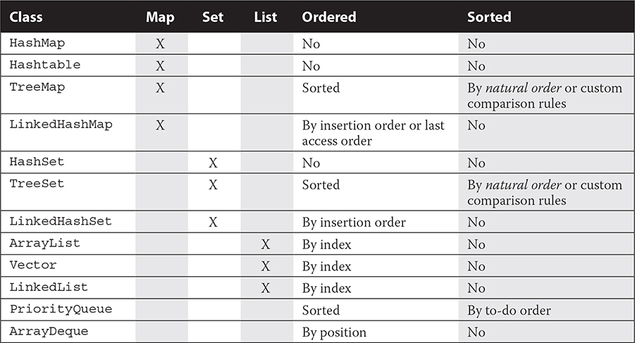
Collections
Feature of Concrete Collection classes

Slide 8
Lambda Expressions

Slide 9
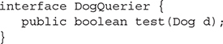
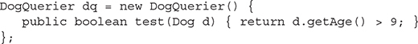
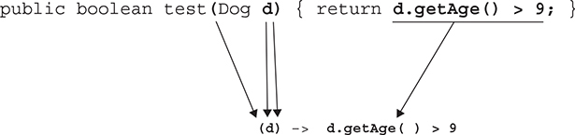
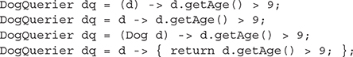
Lambda Expressions
Create Lambda Expressions
Imagine you’ve got a super simple interface, DogQuerier, with one abstract method, test()
You can use inner class to define an instance of a class that implements this interface
We can use lambda expressions to make code more concise
To make the lambda expression, we copy the parameter of the test() method from the inner class, then write an arrow, and then copy the expression in the body of the test method, leaving out the return and the semicolon:
Valid lambda expression of DogQuerier.
The type of the lambda expression is DogQuerier.

Slide 10
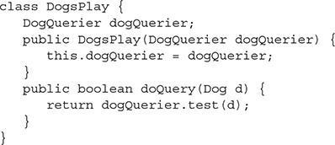
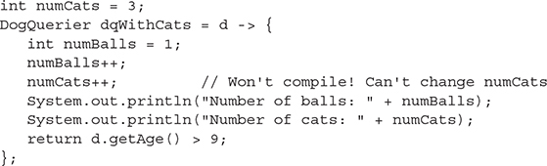
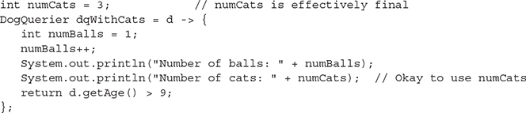
Lambda Expressions
Create Lambda Expressions
Passing Lambda Expressions to methods
Accessing Variables from Lambda Expr
A lambda expression “captures” variables from the enclosing scope, so you can access those variables in the body of the lambda, but those variables must be final or effectively final.

Slide 11
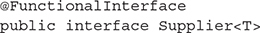
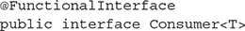
Lambda Expressions
Functional Interfaces
Functional Interface have one abstract method. Default methods don’t count, static methods don’t count and methods inherited from Object don’t count
The basic types of functional interfaces are Supplier, Consumer, Predicate, and Function.
Suppliers supply results. java.util.function.Supplier’s functional method, get(), never takes an argument, and it always returns something.
Consumers consume values. java.util.function.Consumer’s functional method, accept(), always takes an argument and never returns anything.

Slide 12
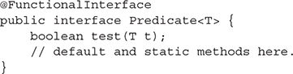
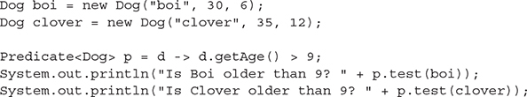
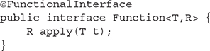
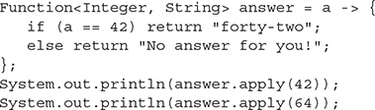
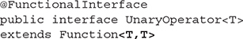
Lambda Expressions
Functional Interfaces
Predicates test things (and do logical operations). java.util.function.Predicate’s functional method, test(), takes a value, does a logical test, and returns true or false.
Functions are the most generic of the functional interfaces. java.util.function.Function’s functional method, apply(), takes an argument and returns a value.

Slide 13
Lambda Expressions
Example of Functional Interface
Which of the following options successfully replace anonymous inner class code with lambda expression code? int operate(int i, int j);
Operator opr = (x, y)-> {return x + y;}
Operator opr = (x, y)->x + y;
Operator opr = (x, y)->return x + y;
Operator opr = (int x, int y)-> {return x + y;}
Operator opr = x, y->x + y;
interface Operator {
int operate(int i, int j);
}
public class Test {
public static void main(String[] args) {
Operator opr = new Operator() {
public int operate(int i, int j) {
return i + j;
}
};
System.out.println(opr.operate(10, 20));
}
}

Slide 14
Streams

Slide 15
Streams
Stream is a sequence of elements to be processed
Integer[] myNums = {1, 2, 3};
Stream<Integer> myStream = Arrays.stream(myNums);
System.out.println(myStream); java.util.Stream.ReferencePipeline$Head@14ae5a5
Streams are not data structure like List is or an array is. They are ways to process data similar to flowing through the stream
Array tells how data is organized and provides way to access the data. Stream are ways to operate on data that’s flowing from an array through the stream
You can have intermediate operations and terminal operations on the Stream
Streams can only be used once.
long numElements = myStream.filter((i)-> i>1).count();
System.out.println(“No of elements > 1” + numElements);
In Java, a stream is an object that gets its data from a source, but it doesn’t store any data itself. The data flowing through the stream can be operated on, multiple times if we want, with intermediate operations, like filter(). The stream ends when we use a terminal operation, like count(), and once we’ve used a stream, we can’t reuse it.
numElements = myStream.filter((i)-> i>2).count();
System.out.println(“No of elements > 2” + numElements);

Slide 16
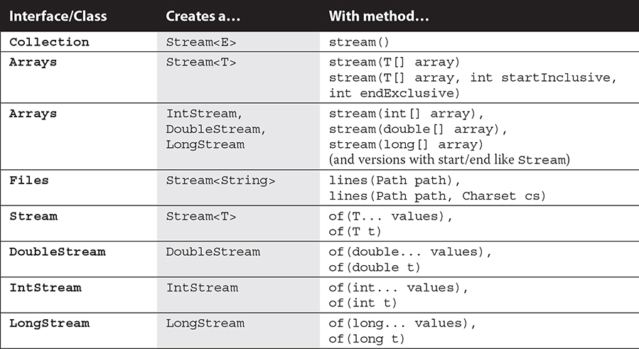
How to create Streams?
What is the difference between a Stream<Double> and DoubleStream?
The first is a stream of Double objects; the second is a stream of double values.

Slide 17
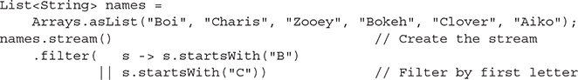
Why Streams?
Benefit – Multiple intermediate operations
So far, we’ve been performing only one intermediate operation: a filter, using a variety of different Predicates to filter the data we get from the stream before we count it. However, when we use multiple intermediate operations, we start seeing the benefits of streams.
Streams use something called a “pipeline”, which can, in some circumstances, dramatically improve the efficiency of data processing.
A stream pipeline consists of three parts: a source, zero or more intermediate operations, and a terminal operation. The source describes where the data is coming from; the intermediate operations operate on the stream and produce another, perhaps modified, stream; and the terminal operation ends the stream and typically produces a value or some output.

Slide 18
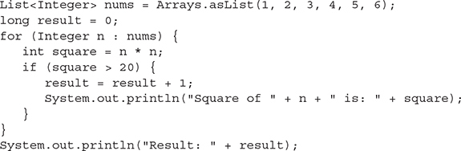
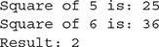
Map-filter-reduce
abstraction to describe functions that operate on a sequence of elements
map() method takes a Function and transforms elements of a stream
filter() takes a Predicate and tests each element in the stream pipeline, producing a stream of elements that pass the test
reduce() method is a general method for reducing a stream to a value. The methods count(), average(), min(), max(), and sum() are all reduction methods already defined on streams. You can also define your own reductions using the reduce() method.
Here is Java 7 way:
Output

Slide 19
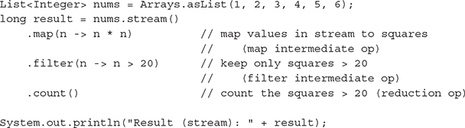
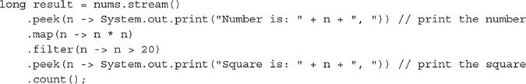
Map-filter-reduce
Here is Java 8 way using Streams:
Output
Output

Slide 20
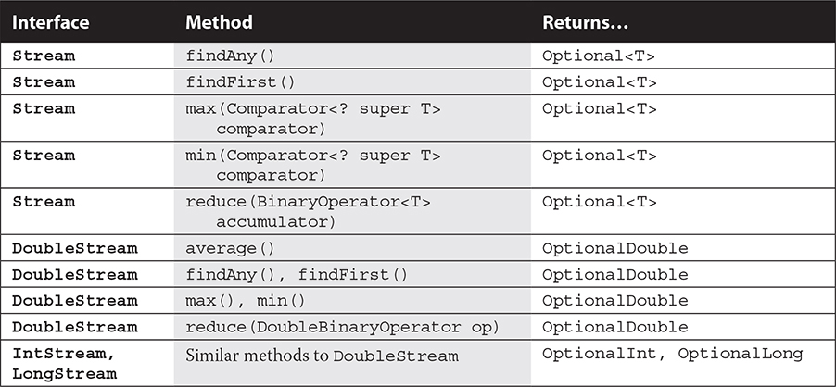
Optionals
Container or Wrapper that may or may not have a value
Some stream methods produce Optional values e.g. average(), findAny()
Why Optionals? If a stream is empty at any part of the pipeline, then there’s a chance that no value will be returned by the terminal operation of a stream pipeline. Optionals provide a way for the JDK to handle that situation without having to throw a runtime exception.
The types of optionals include Optional<T> (for objects) and three primitive optionals, OptionalDouble, OptionalInt, and OptionalLong.

Slide 21
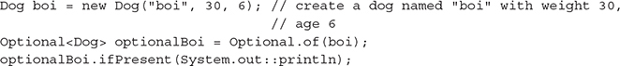
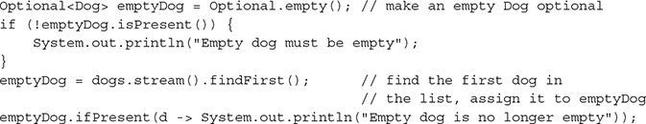
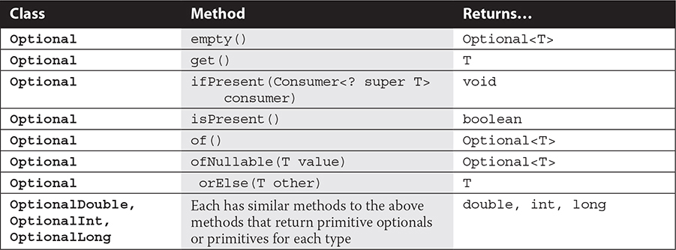
Optionals
Output

Slide 22
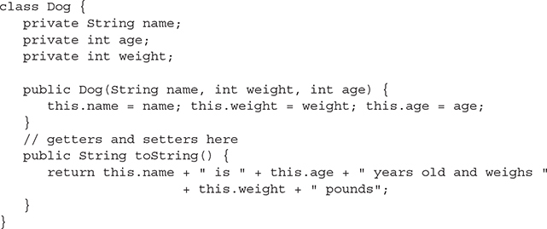
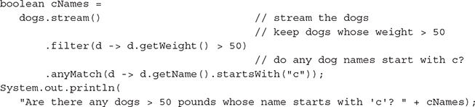
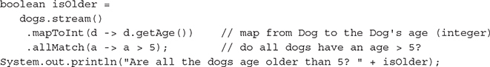
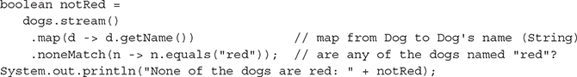
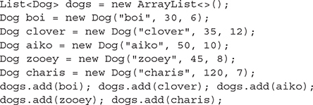
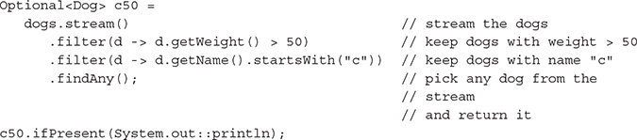
Searching
The Stream interface provides several methods for searching for elements in streams: allMatch, anyMatch, noneMatch, findFirst, and findAny. All of these operations are terminal operations; that is, they all return a single value, not a stream.

Slide 23
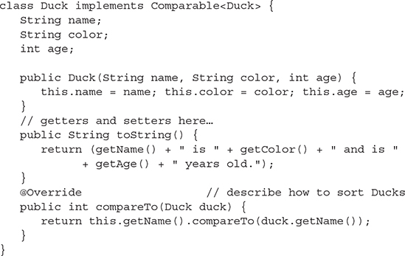
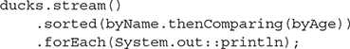
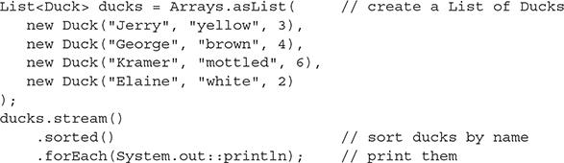
Sorting
The Stream interface provides sorted method to sort elements in streams by natural order or by providing a Comparator to determine the order. How do you sort complex elements?

Slide 24
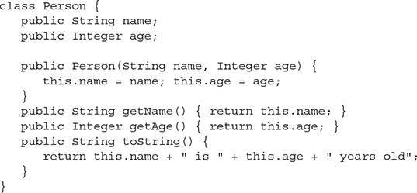
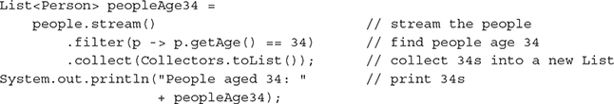
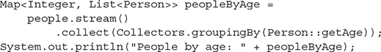
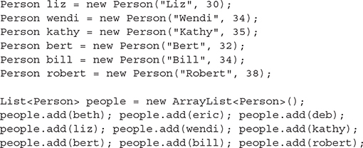
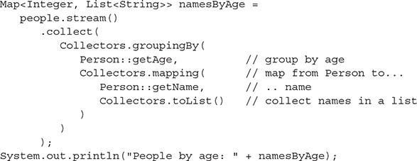
Collection from Stream
You can collect elements in a stream in a new Collection using collect() method. The collect() method is reduction (terminal) operation
Use the Collectors.toList() method to create a Collector that accumulates stream elements into a List. Collectors.toMap() and Collectors.toSet() accumulate stream elements into a Map and Set, respectively

Slide 25
Examples

Slide 26

Q1
What will be the result of compiling and executing Test class?
import java.util.Arrays;
import java.util.List;
import java.util.stream.Collectors;
class Book {
String title;
String author;
double price;
public Book(String title, String author, double price) {
this.title = title;
this.author = author;
this.price = price;
}
public String getAuthor() {
return this.author;
}
public String toString() {
return "{" + title + "," + author + "," + price + "}";
}
}
public class Test {
public static void main(String[] args) {
List<Book> books = Arrays.asList(
new Book ("Head First Java", "Kathy Sierra", 24.5),
new Book ("OCP", "Udayan Khattry", 20.99),
new Book ("OCA", "Udayan Khattry", 14.99));
books.stream().collect(Collectors.groupingBy(Book::getAuthor))
.forEach((a,b) -> System.out.println(a));
}
}
OPTIONS
Kathy Sierra
Udayan Khattry
2) [{Head First Java, Kathy Sierra, 24.5}]
[{OCP, Udayan Khattry, 20.99}, {OCA, Udayan Khattry, 14.99}]
3) Run Time Exception
Notes:
books --> [{Head First Java,Kathy Sierra,24.5}, {OCP,Udayan Khattry,20.99}, {OCA,Udayan Khattry,14.99}]. Ordered by insertion order. books.stream() returns Stream<Book> type: [{Head First Java,Kathy Sierra,24.5}, {OCP,Udayan Khattry,20.99}, {OCA,Udayan Khattry,14.99}]. books.stream().collect(Collectors.groupingBy(Book::getAuthor)) returns a Map<String, List<Book>> type, key is the author name and value is the List of book objects. map --> [{Kathy Sierra, {Head First Java,Kathy Sierra,24.5}}, {Udayan Khattry, {{OCP,Udayan Khattry,20.99}, {OCA,Udayan Khattry,14.99}}}]. forEach method accepts a BiConsumer<String, List<Book>> , so first parameter of accept method is key and 2nd parameter is value.
So in the given lambda expression 'a' is key and 'b' is value. System.out.println(a) prints keys(author names) to the console.

Slide 27
Q2
What will be the result of compiling and executing Test class?
import java.util.Arrays;
import java.util.List;
public class Test {
public static void main(String[] args) {
List<String> codes = Arrays.asList("1st", "2nd", "3rd", "4th");
System.out.println(codes.stream().filter(
s -> s.endsWith("d")).reduce((s1, s2) -> s1 + s2));
}
}
OPTIONS
Optional[2nd3rd]
1st4th
Optional[1st4th]
2nd3rd
import java.util.Arrays;
import java.util.List;
public class Test {
public static void main(String[] args) {
List<String> codes = Arrays.asList("1st", "2nd", "3rd", "4th");
System.out.println(codes.stream().filter(
s -> s.endsWith("d")).reduce(“”, (s1, s2) -> s1 + s2));
}
}
Notes:
filter method filters all the strings ending with "d". 'stream.reduce((s1, s2) -> s1 + s2)' returns 'Optional<String>' type whereas 'stream.reduce("", (s1, s2) -> s1 + s2)' returns 'String'.

Slide 28
Q3
What will be the result of compiling and executing Test class?
import java.util.ArrayList;
import java.util.List;
class MyString {
String str;
MyString(String str) {
this.str = str;
}
}
public class Test {
public static void main(String[] args) {
List<MyString> list = new ArrayList<>();
list.add(new MyString("Y"));
list.add(new MyString("E"));
list.add(new MyString("S"));
list.stream().map(s -> s).forEach(System.out::print);
}
}
OPTIONS
YES
Compilation Error
Run time Exception
Prints nothing
Prints something other than YES
Notes:
MyString class doesn't override toString() method, hence when instance of MyString class passed to System.out.print(...) method, it prints <fully-qualified-class-name>@<hex-value-of-hashcode>.
To print "YES" on to the console, change the last statement to: list.stream().map(s -> s.str).forEach(System.out::print);
's' represents the instance of MyString class and as MyString class is defined within the same package, hence instance variable 'str' can be accessed using dot operator.

Slide 29
Q4
What will be the result of compiling and executing Test class?
import java.util.ArrayList;
import java.util.List;
public class Test {
public static void main(String[] args) {
int ref = 10;
List<Integer> list = new ArrayList<>();
list.stream().anyMatch(i -> {
System.out.println("HELLO");
return i > ref;
});
}
}
import java.util.ArrayList;
import java.util.List;
public class Test {
public static void main(String[] args) {
int ref = 10;
List<Integer> list = new ArrayList<>();
list.stream().anyMatch(i -> {
System.out.println("HELLO");
return i > ++ref;
});
}
}
OPTIONS
Successful execution with printing anything
Compilation Error
HELLO
Notes:
Method signature for anyMatch method:
boolean anyMatch(Predicate<? super T>) : Returns true if any of the stream element matches the given Predicate.
If stream is empty, it returns false and predicate is not evaluated.
1. As given stream is empty, hence predicate is not evaluated and nothing is printed on to the console.
2. ref is a local variable and it is used within lambda expression. ++ref causes compilation failure as variable ref should be effectively final.

Slide 30
Q5
What will be the result of compiling and executing Test class?
import java.util.List;
import java.util.Map;
import java.util.stream.Collectors;
import java.util.stream.Stream;
class Certification {
String studId;
String test;
int marks;
Certification(String studId, String test, int marks) {
this.studId = studId;
this.test = test;
this.marks = marks;
}
public String toString() {
return "{" + studId + ", " + test + ", " + marks + "}";
}
public String getStudId() {
return studId;
}
public String getTest() {
return test;
}
public int getMarks() {
return marks;
}
}
public class Test {
public static void main(String[] args) {
Certification c1 = new Certification("S001", "OCA", 87);
Certification c2 = new Certification("S002", "OCA", 82);
Certification c3 = new Certification("S001", "OCP", 79);
Certification c4 = new Certification("S002", "OCP", 89);
Certification c5 = new Certification("S003", "OCA", 60);
Certification c6 = new Certification("S004", "OCA", 88);
Stream<Certification> stream = Stream.of(c1, c2, c3, c4, c5, c6);
Map<Boolean, List<Certification>> map =
stream.collect(Collectors.partitioningBy(s -> s.equals("OCA")));
System.out.println(map.get(true));
}
}
OPTIONS
[]
2) [{S001, OCP, 79}, {S002, OCP, 89}]
3) [{S001, OCA, 87}, {S002, OCA, 82}, {S001, OCP, 79}, {S002, OCP, 89}, {S003, OCA, 60}, {S004, OCA, 88}]
4) [{S001, OCA, 87}, {S002, OCA, 82}, {S003, OCA, 60}, {S004, OCA, 88}]
Notes:
Collectors.partitioningBy(s -> s.equals("OCA")) => s in this lambda expression is of Certification type and not String type.
This means predicate 's -> s.equals("OCA")' will return false for "OCA". None of the certification object will return true and hence no element will be stored against 'true'.
[] will be printed in the output.
Correct predicate will be: 's -> s.getTest().equals("OCA")'.

Slide 31
Q6
What will be the result of compiling and executing Test class?
import java.util.Arrays;
import java.util.List;
import java.util.function.Predicate;
public class Test {
public static void main(String[] args) {
List<Integer> list = Arrays.asList(-80, 100, -40, 25, 200);
Predicate<Integer> predicate = num -> {
int ctr = 1;
boolean result = num > 0;
System.out.print(ctr++ + ".");
return result;
};
list.stream().filter(predicate).sorted();
}
}
import java.util.Arrays;
import java.util.List;
import java.util.function.Predicate;
public class Test {
public static void main(String[] args) {
List<Integer> list = Arrays.asList(-80, 100, -40, 25, 200);
Predicate<Integer> predicate = num -> {
int ctr = 1;
boolean result = num > 0;
System.out.print(ctr++ + ".");
return result;
};
list.stream().filter(predicate).sorted().count();
}
}
OPTIONS
1.
2) 1.1.1.1.1.
3) 1.2.
4) 1.1.
5) Nothing is printed on the console

Slide 32
Q7
What will be the result of compiling and executing Test class?
import java.util.Arrays;
import java.util.stream.Stream;
public class Test {
public static void main(String[] args) {
Stream<Integer> stream = Arrays.asList(1,2,3,4,5).stream();
System.out.println(stream.mapToInt(i -> i).average().getAsInt());
}
}
OPTIONS
3
Compilation Error
Run time Exception
Notes:
stream.mapToInt(i -> i) => returns an instance of IntStream. average() method of all the 3 primitive streams (IntStream, LongStream & DoubleStream) return an instance of OptionalDouble. OptionalDouble has getAsDouble() method and not getAsInt() method.

Slide 33
Q8
Which of the following options can replace /*INSERT*/ ?
import java.util.ArrayList;
import java.util.Comparator;
import java.util.List;
class Fruit implements Comparable<Fruit>, Comparator<Fruit> {
String name;
String countryOfOrigin;
Fruit() {}
Fruit(String name, String countryOfOrigin) {
this.name = name;
this.countryOfOrigin = countryOfOrigin;
}
public String toString() {
return name + ":" + countryOfOrigin;
}
@Override
public int compareTo(Fruit o) {
return this.name.compareToIgnoreCase(o.name);
}
@Override
public int compare(Fruit o1, Fruit o2) {
return o1.countryOfOrigin.compareToIgnoreCase(o2.countryOfOrigin);
}
public static int comp(String s1, String s2) {
return s2.compareToIgnoreCase(s1);
}
}
public class Test {
public static void main(String[] args) {
List<Fruit> list = new ArrayList<>();
list.add(new Fruit("Olive", "Middle East"));
list.add(new Fruit("Mango", "India"));
list.add(new Fruit("Cranberry", "North America"));
list.add(new Fruit("Watermelon", "Africa"));
list.add(new Fruit("Peach", "China"));
list.add(new Fruit("Fig", "Middle East"));
list.add(new Fruit("Blueberry", "North America"));
/* INSERT */
}
}
Desired output is below
Cranberry:North America
Blueberry:North America
Olive:Middle East
Fig:Middle East
Mango:India
Peach:China
Watermelon:Africa
OPTIONS for INSERT
list.stream().sorted().forEach(System.out::println);
list.stream().sorted(new Fruit()).forEach(System.out::println);
list.stream().sorted(Comparator.comparing(f->.f.countryOfOrigin, Fruit::comp)).forEach(System.out::println);
list.stream().sorted(new Fruit().reversed()).forEach(System.out::println);
Notes:
As Comparable and Comparator are interfaces, so Fruit class can implement both the interfaces. Given code compiles successfully. compareTo(Fruit) method of Comparable interface will help to sort in ascending order of Fruit's name and compare(Fruit, Fruit) method of Comparator interface will help to sort in ascending order of Fruit's country of origin. By looking at the expected output it is clear that output is arranged in descending order of Fruit's country of origin. This means Comparator needs to be used in reversed order. Out of the given options 'list.stream().sorted(new Fruit().reversed()).forEach(System.out::println);' will display the expected output. 'list.stream().sorted()' sorts Fruit instances on the basis of ascending order of their names, not the correct option. 'list.stream().sorted(new Fruit())' sorts Fruit instances on the basis of ascending order of their country of origin, not the correct option. 'list.stream().sorted(Comparator.comparing(f -> f.countryOfOrigin, Fruit::comp))': keyExtractor is accepting Fruit object and returning countryOfOrigin, which is of String type. The 2nd argument passed is Fruit::comp, which is keyComparator and it sorts the Fruit objects in descending order of the key (courntryOfOrigin) in this case. Hence this is also a correct option.

Slide 34
Q9
What will be the result of compiling and executing Test class?
OPTIONS
prevention
prehistoric
president
presentation
previous
2) prehistoric
presentation
3) prevention
prehistoric
presentation
4) Presentation
5) prevention
prehistoric
president
Presentation
6) Program terminates without printing anything on console
import java.util.function.BiFunction;
import java.util.function.BiPredicate;
public class Test {
public static void main(String[] args) {
BiFunction<String, String, String> func = (str1, str2) -> {
return (str1 + str2);
};
BiPredicate<String, String> predicate = (str1, str2) -> {
return func.apply(str1, str2).length() > 10;
};
String [] arr = {"vention", "historic", "sident", "sentation", "vious"};
for(String str : arr) {
if(predicate.test("pre", str)) {
System.out.println(func.apply("pre", str));
}
}
}
}
Notes:
BiFunction<T, U, R> : R apply(T t, U u); BiFunction interface accepts 3 type parameters, first 2 parameters (T,U) are passed to apply method and 3rd type parameter is the return type of apply method. In this case, 'BiFunction<String, String, String>' means apply method will have declaration: 'String apply(String str1, String str2)'. Given lambda expression '(str1, str2) -> { return (str1 + str2); };' is the correct implementation of BiFunction<String, String, String> interface. It simply concatenates the passed strings. BiPredicate<T, U> : boolean test(T t, U u); BiPredicate interface accepts 2 type parameters and these parameters (T,U) are passed to test method, which returns primitive boolean. In this case, 'BiPredicate<String, String>' means test method will have declaration: 'boolean test(String s1, String s2)'. Given lambada expression '(str1, str2) -> { return func.apply(str1, str2).length() > 10; };' is correct implementation of BiPredicate<String, String>. Also note, lambda expression for BiPredicate uses BiFunction. This predicate returns true if combined length of passed strings is greater than 10. For-each loop simply iterates over the String array elements and prints the string after pre-pending it with "pre" in case the combined length of result string is greater than 10.
"prehistoric" has 11 characters and "presentation" has 12 characters and hence these are displayed in the output.

Slide 35
Q10
What will be the result of compiling and executing Test class?
import java.util.Arrays;
import java.util.List;
import java.util.function.Consumer;
interface StringConsumer extends Consumer<String> {
@Override
public default void accept(String s) {
System.out.println(s.toUpperCase());
}
}
public class Test {
public static void main(String[] args) {
StringConsumer consumer = s -> System.out.println(s.toLowerCase());
List<String> list = Arrays.asList("Dr", "Mr", "Miss", "Mrs");
list.forEach(consumer);
}
}
OPTIONS
Runtime Exception
Compilation Error
dr
mr
Miss
mrs
4) DR
MR
MISS
MRS
Notes:
Target type of lambda expression should be a functional interface. StringConsumer is not a Functional Interface as it just specifies one default method, abstract method is not available. Statement 'StringConsumer consumer = s -> System.out.println(s.toLowerCase());' causes compilation error.

Slide 36
Q11
What will be the result of compiling and executing Test class?
import java.util.Arrays;
import java.util.List;
import java.util.function.Consumer;
interface StringConsumer extends Consumer<String> {
@Override
public default void accept(String s) {
System.out.println(s.toUpperCase());
}
}
public class Test {
public static void main(String[] args) {
StringConsumer consumer = new StringConsumer() {
@Override
public void accept(String s) {
System.out.println(s.toLowerCase());
}
};
List<String> list = Arrays.asList("Dr", "Mr", "Miss", "Mrs");
list.forEach(consumer);
}
}
OPTIONS
Runtime Exception
Compilation Error
dr
mr
miss
mrs
4) DR
MR
MISS
MRS
Notes:
list is of List<String> type, so list.forEach(...) method can accept argument of Consumer<String> type.
interface StringConsumer extends Consumer<String>, which means instances of StringConsumer will also be instances of Consumer<String>.
Note: StringConsumer is not a Functional Interface as it just specifies one default method.
Reference variable 'consumer' refers to an instance of anonymous subclass of StringConsumer and overrides accept(String) method.
list.forEach(consumer); => Prints list elements in lower case as overriding version of anonymous inner class is used.

Slide 37
Q12
What will be the result of compiling and executing Test class? – 2 Options
import java.util.ArrayList;
import java.util.List;
public class Test {
public static void main(String[] args) {
List list = new ArrayList<String>();
list.add(1);
list.add("2");
list.forEach(System.out::print);
}
}
OPTIONS
12 is displayed on the console
Compilation Warnings
Run time Exception
Code compiles without any warnings or error
Notes:
Compiler warning for unchecked call to add and forEach.list can store all objects and when each element is passed to System.out.print() method, toString() method for passed element is invoked.
Both Integer and String class overrides toString() method and hence 12 is printed on to the console.

Slide 38
Thank You
धन्यवाद
dhanyavaad
நன்றி
Naṉṟi

